Slide 1





Access to Technology
Solo Silo
Dubstech 7th Datathon
Jah Chen

Slide 2

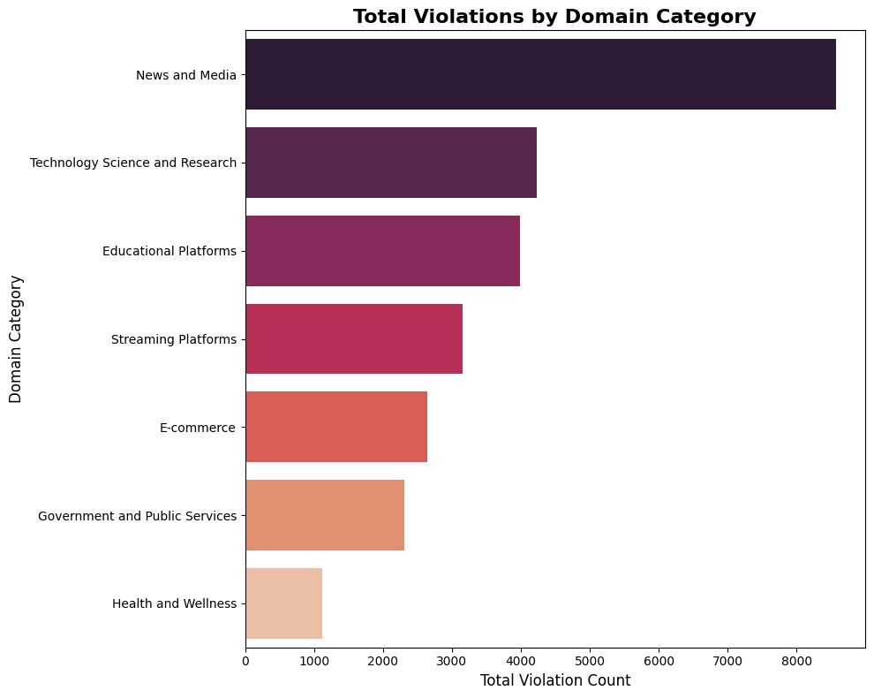
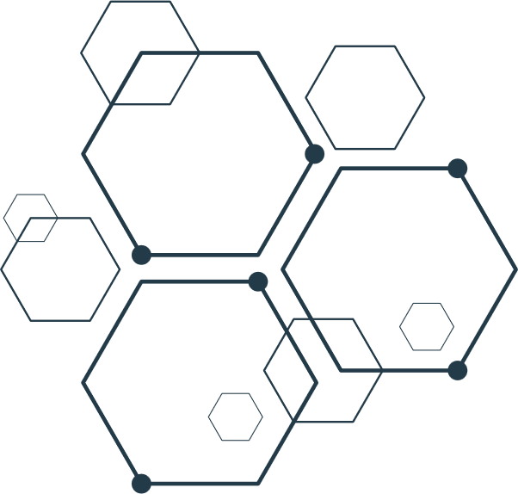
Access to Technology
Solo Silo
Data Analysis
Understand Domains
Which domains (health, education, government, etc.) have the highest number of accessibility violations?
News and Media has the greatest number of violations.
News and Media doubles that of Technology Science and Research.
78,000+

Slide 3

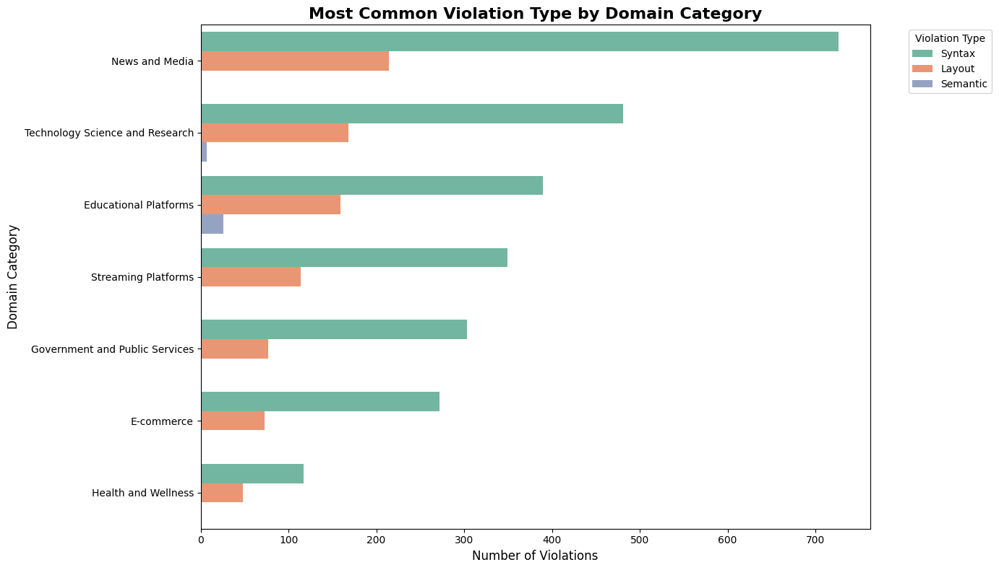
Access to Technology
Data
Analysis
What violation types are most common across each domain category?
Syntax
Large Gaps

Slide 4
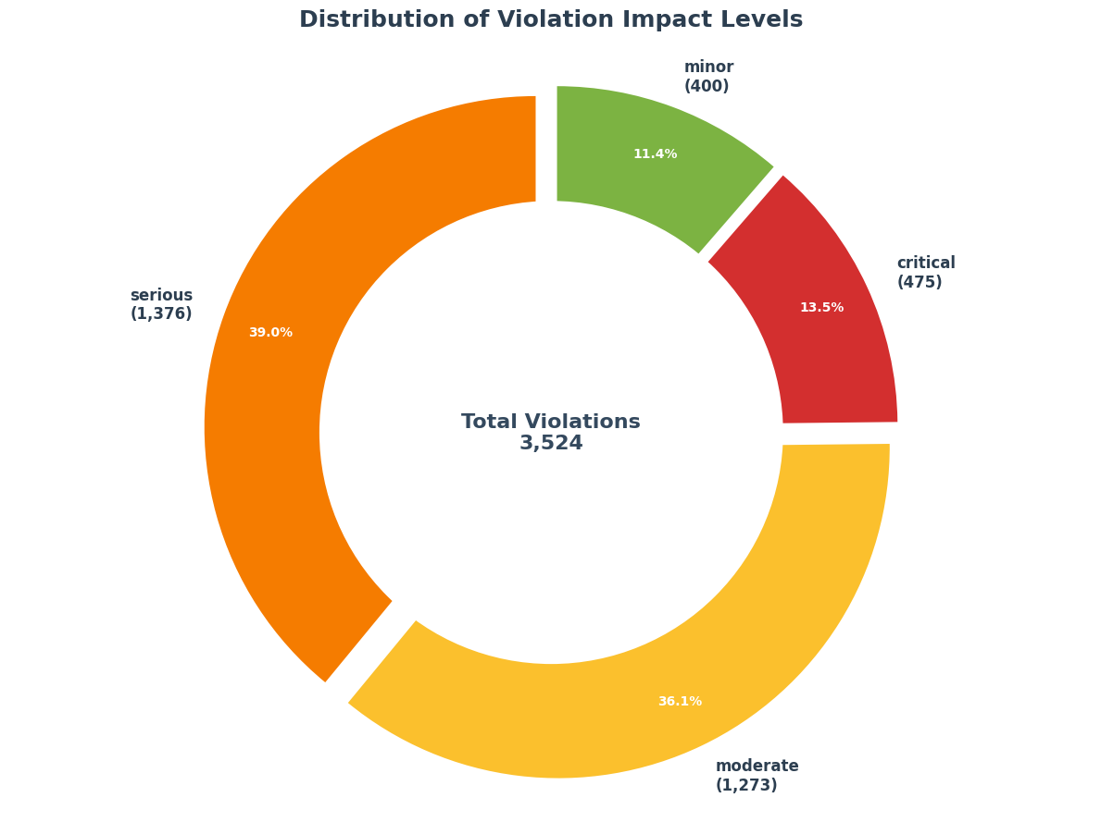
Violations Impact

Slide 5
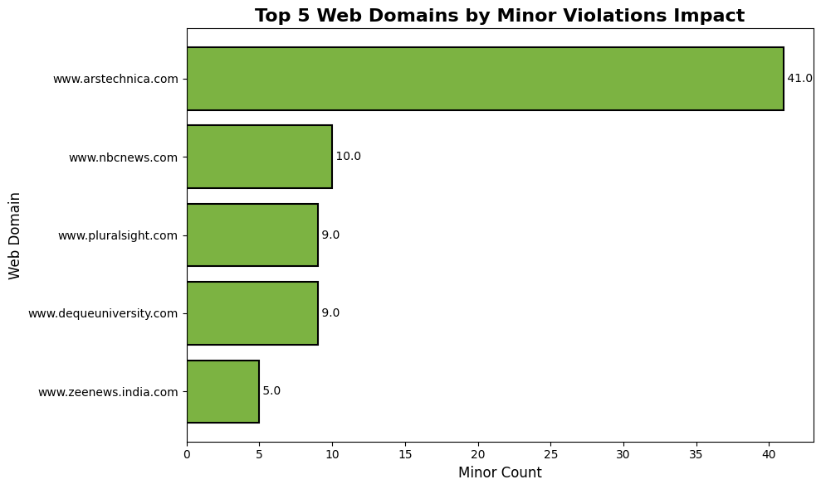
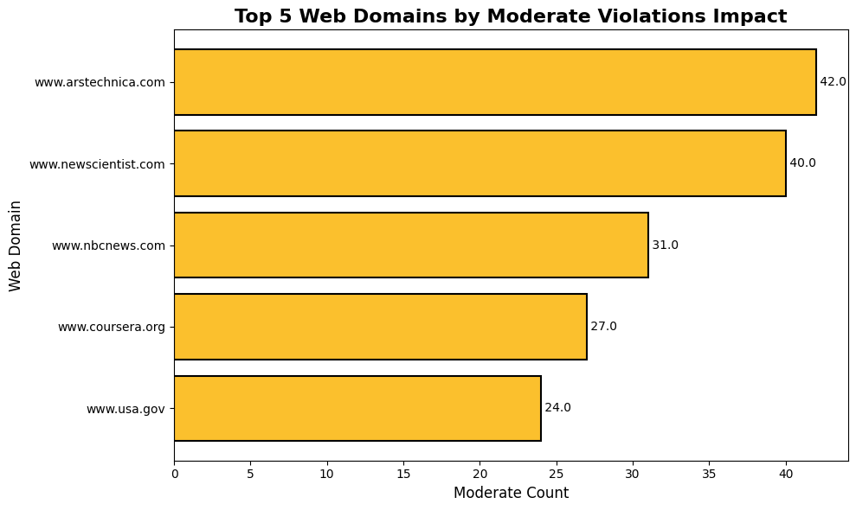
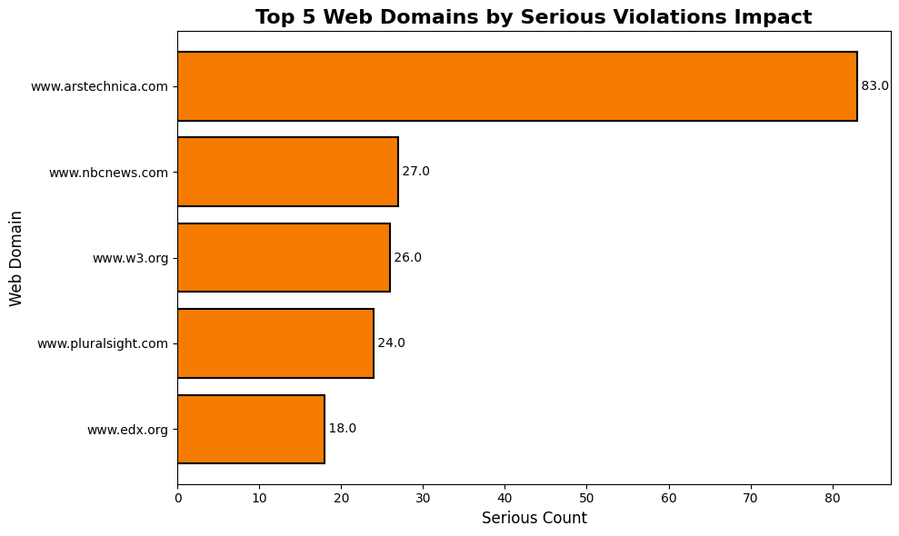
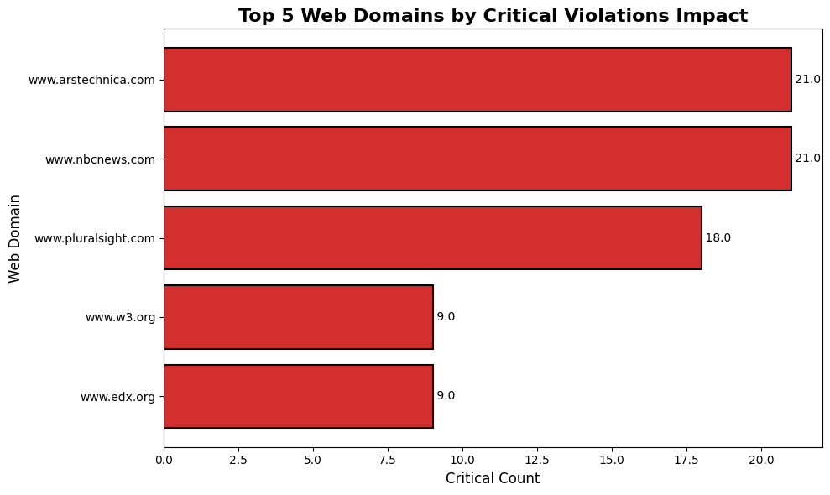
Access to Technology
Solo Silo
Violations Impact

Slide 6
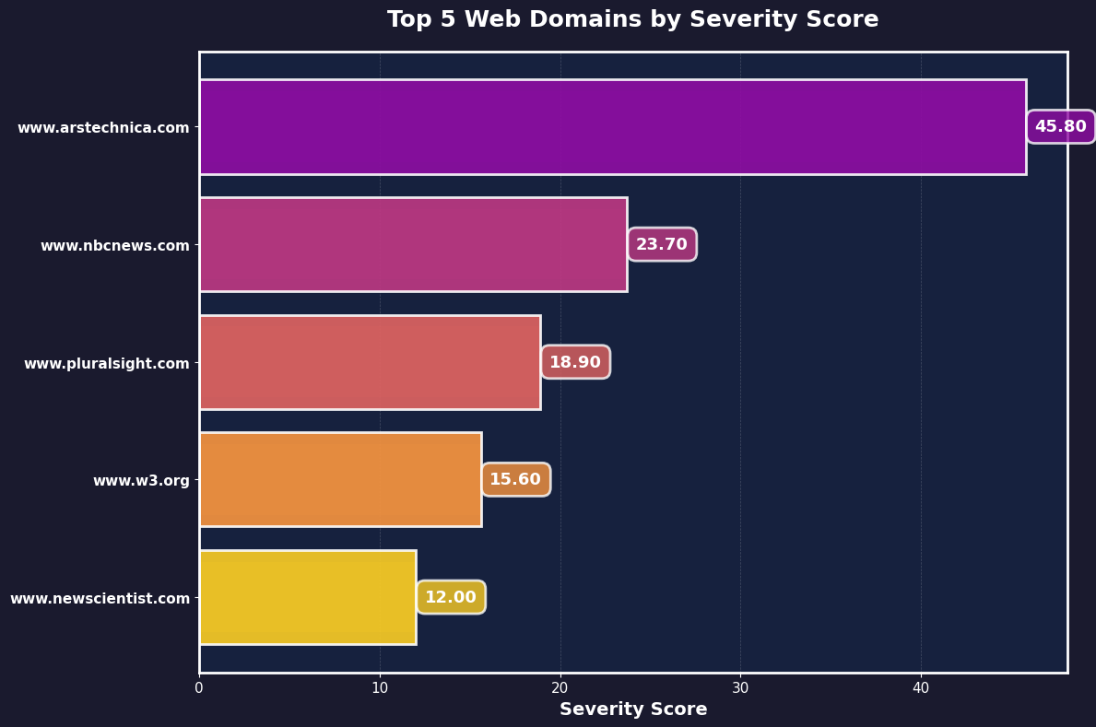
Access to Technology
Solo Silo
Severity Score
Which web domain has the most severe accessibility issues?
Arstechnica ranked first
Arstechnia doubles second rank

Slide 7
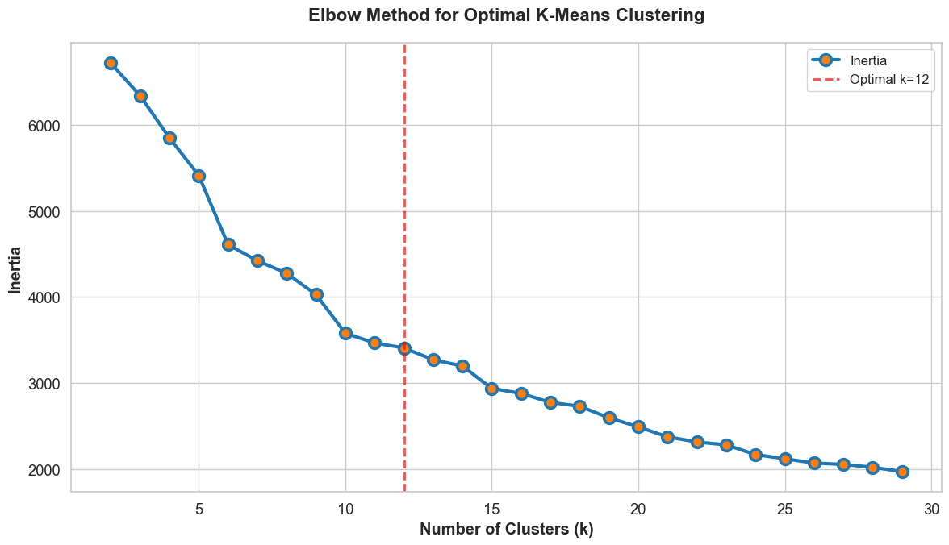


Access to Technology
Solo Silo
Unsupervised Learning
K-means
Fixed number of spherical groupings by minimizing points from centroids.
Explainable
Fast
Agglomerative Clustering
Builds clusters within clusters to highlight hierarchical differences.
Flexible
Hierarchical

Slide 8
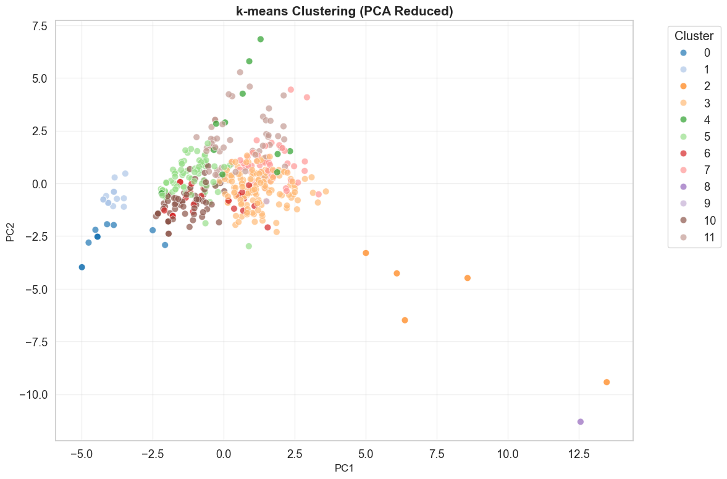
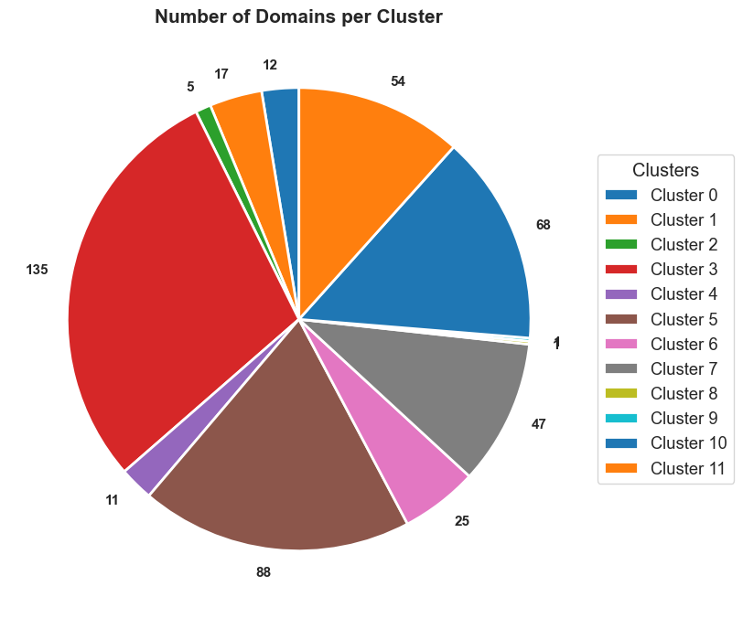



Access to Technology
Solo Silo
Quantum AI
Combining AI with The Best quantum computing
Testing the Water
Too many clusters, too many outliers!

Slide 9
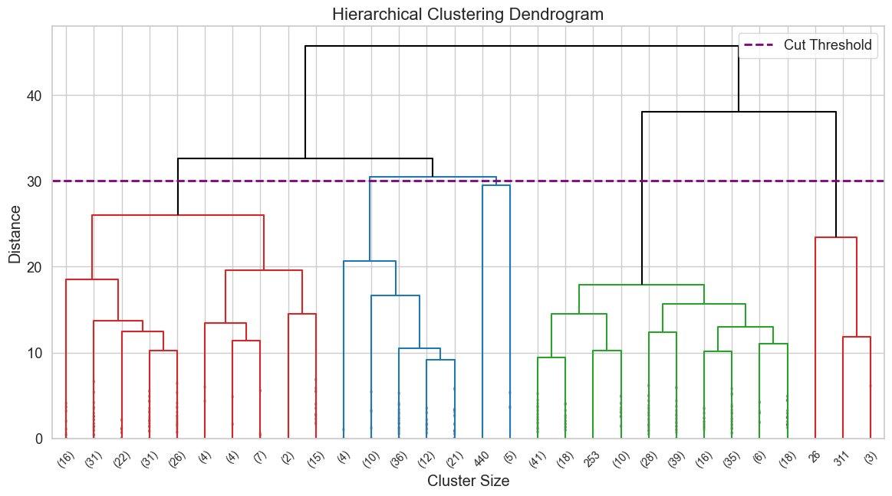



Slide 10

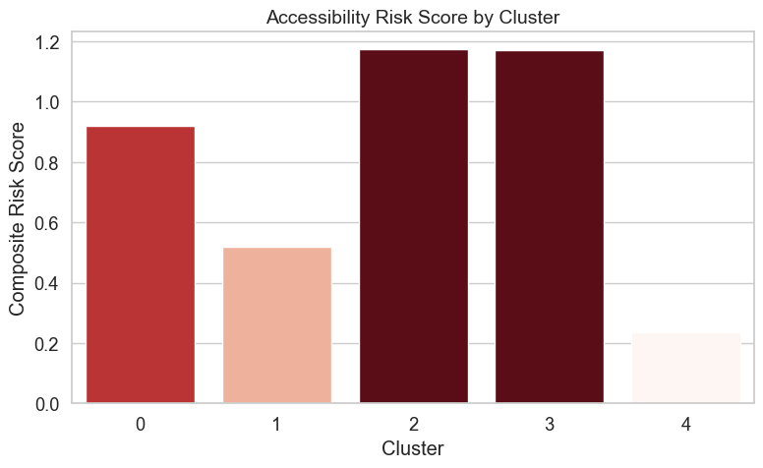
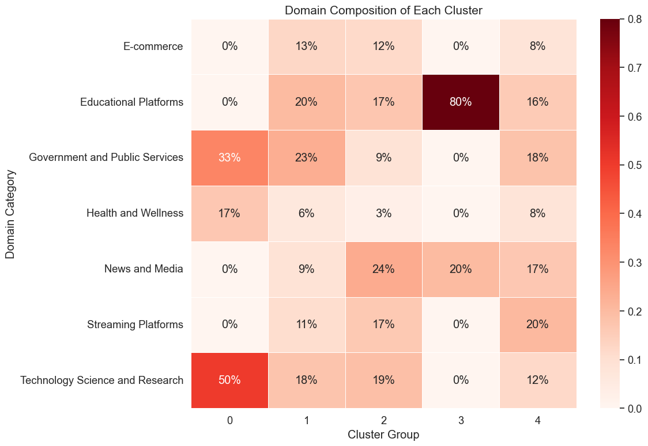

Access to Technology
Solo Silo
1943-1956
The Pioneering Era
McCulloch & Pitts artificial neuron model (1943)
Turing's "Computing Machinery and Intelligence" (1950)
Risk Profiling
Understand what each clusters mean!
Cluster 0 and 3 are found to be outliers!

Slide 11

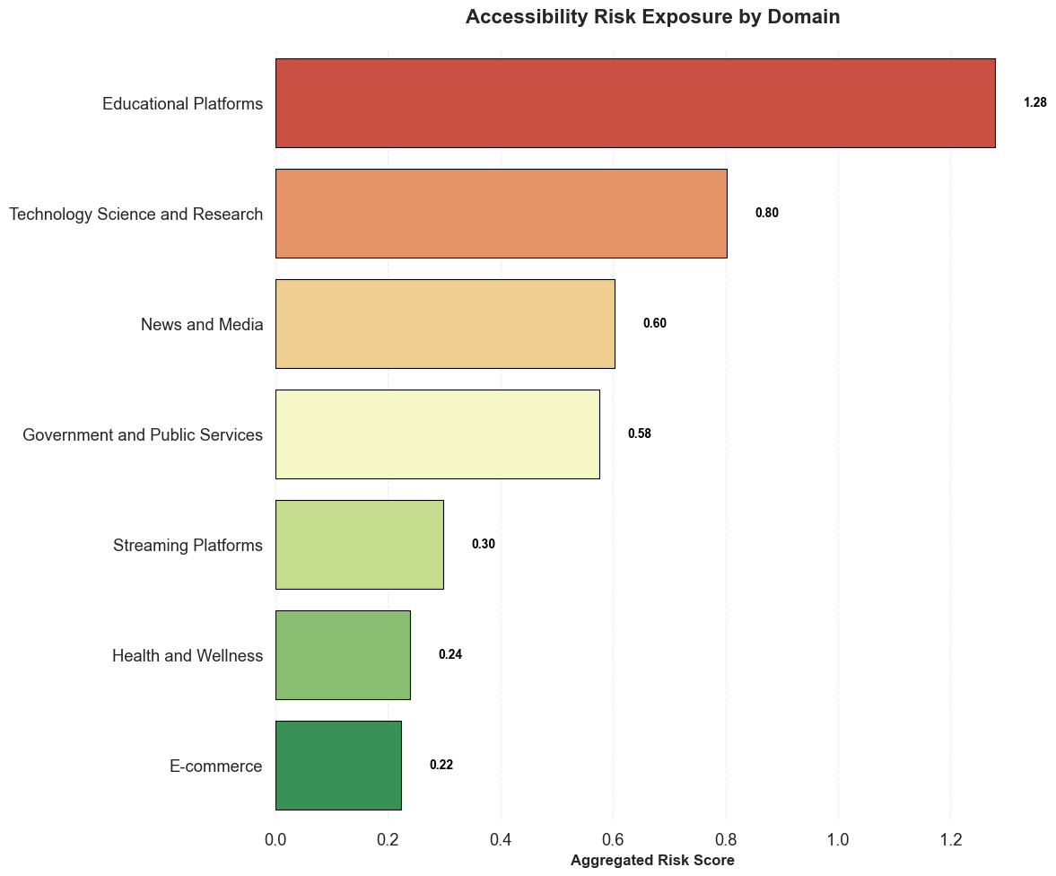
Access to Technology
Solo Silo
1943-1956
The Pioneering Era
McCulloch & Pitts artificial neuron model (1943)
Turing's "Computing Machinery and Intelligence" (1950)
Result
While cluster membership does not imply causality, the concentration of high-risk domains within outlier clusters indicates that these clusters capture accessibility patterns associated with elevated risk.
1974-1980
Early Enthusiasm
Dartmouth Workshop (1956) - the birth of AI as a field
Development of first AI programs (Logic Theorist, ELIZA)

